Slide 1

Troubleshooting .NET Memory Issues

Slide 2
Memory Leaks
Unmanaged
Symptom: Private Bytes increase while #Bytes In All Heaps remains flat
Troubleshooting path: Various tools (DebugDiag, LeakDiag, etc.)
Managed
Symptom: Private Bytes and #Bytes In All Heaps both increase
Troubleshooting path: For most cases, one or more dump files

Slide 3
Symptoms in ASP.NET
Out Of Memory Exceptions
Memory Recycling
memoryLimit
PeriodicRestartMemory
PeriodicRestartPrivateMemory
System event log: worker process recycles if memory limit set
Log Name: System
Source: Microsoft-Windows-WAS
Date: 7/16/2010 1:15:27 AM
Event ID: 5117
Task Category: None
Level: Information
Keywords: Classic
User: N/A
Computer: <COMPUTER NAME>
Description:
A worker process with process id of '7420' serving application pool 'DefaultAppPool' has requested a recycle because it reached its private bytes memory limit.

Slide 4
Demonstration: Memory Leaks
The instructor will demonstrate how to determine the difference between unmanaged and managed leaks

Slide 5
Understanding Managed Memory
Managed heaps
Loader heap
Native heaps
Threads
Images (.dll files)
Other (virtual allocations)
Free
0x00000000
0x7FFFFFFF
Notes:
Commands to demonstrate:
!address -summary
Lm List of loaded modules
!eeheap –gc GC Heap info
!HeapStat
!eeheap –loader Loader Heap info
!heap s Nativ e heap info – Not working on the debugger version 6.3.9600.16384

Slide 6
GC Heap
Segments
Reserved “chunks” of virtual memory
Small Object Heap (SOH) segment(s)
Objects categorized in generations
Gen 0, 1 & 2
Large Object Heap (LOH) segments
“House” large objects
New object created at increasing addresses of the heap
Allocation is very fast
Notes:
Demonstrate !eeheap –gc command

Slide 7
Generations: Structure and Benefits
One heap for generations 0, 1, 2 and large objects
Large Object is > 85,000 bytes
Efficient memory usage
Locality of reference
Objects close together on heap
Allocated consecutively and stored contiguously
Created at same time and therefore related
Speed of allocations
Locality of reference
Allocations located by adding value to a pointer

Slide 8
What can trigger a garbage collection?
Allocation request that cannot be satisfied
Explicit call to GC.Collect()
Under high system memory pressure

Slide 9
GC Sequence
SuspendEE
Mark
gc_heap::mark_phase
Plan
gc_heap::plan_phase
No
Compact?
Sweep
make_free_lists
Yes
Relocate
gc_heap::relocate_phase
RestartEE
Compact
gc_heap::compact_phase
Notes:
GC Phases
Mark – goal to find live objects
Plan – decide to compact or not
Relocate – Find & update references to live objects
Compact – copies objects to new locations
Sweep – put dead objects into free list

Slide 10
GC Sequence in Motion
1
2
3
5
11
12
13
14
15
16
4
6
7
8
9
10
Gen 2
Gen 0
Gen 1
Relocate+Compactt
Plan
Mark
Notes:
10

Slide 11
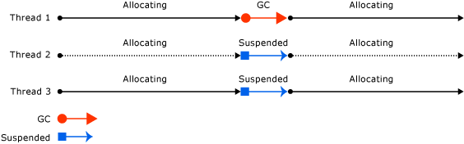
Non-Concurrent Workstation GC

Slide 12
What’s new in 4.0
Background GC vs Ephemeral GC
Full GC is running in the Background
If required ephemeral collection is possible at the same time
Background GC is suspended while the allocating thread is doing the collection
For Concurrent Workstation mode only

Slide 13
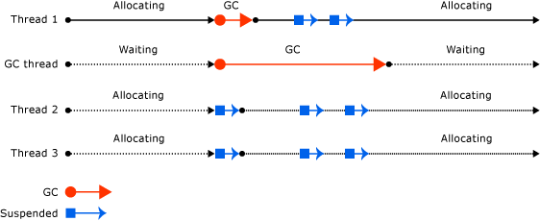
Concurrent Workstation GC
Background GC in action!

Slide 14
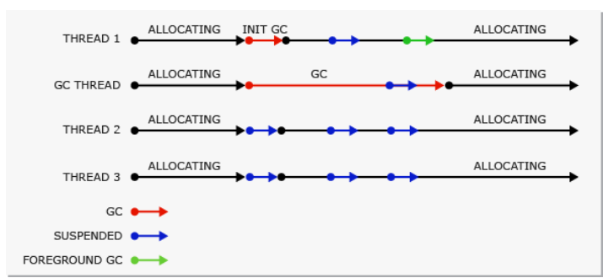
Background Workstation GC

Slide 15
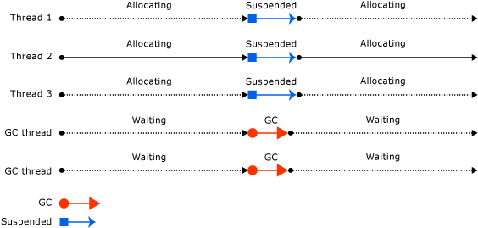
Server GC

Slide 16
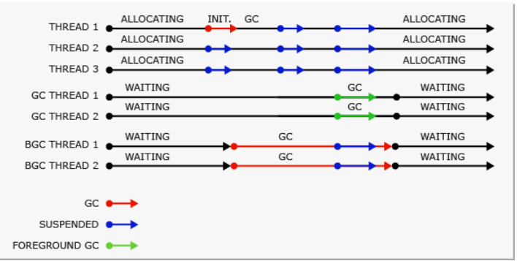
Background Server GC

Slide 17
What’s new in 4.5
Background GC available on server as well
High throughput due to balanced LOH
Improved LOH allocation; reduces LOH fragmentation
On x64 objects > 2 GB can be allocated; use <gcAllowVeryLargeObjects> setting enable this feature

Slide 18
Maximizing GC Performance
Consider problems caused by the following :
Pre-allocating objects
Too many roots (keeping objects alive)
Pointer/Reference rich objects
E.g. “Kitchen Sink” static/GCHandle cache such as Hashtable
Too many almost-long-lived objects (generational churn)
Pinning (GCHandleType.Pinned, Interop, fixed location)
Too many Weak references to really small objects
Extensive using of the LOH results in fragmentation
Notes:
Prevent the Promotion of Short-Lived Objects
Do not reference short-lived objects from long-lived objects. A common example where this occurs is when you assign a local object to a class level object reference.
Avoid having finalizable objects refer to anything
Set Unneeded Member Variables to Null Before Making Long-Running Calls
Avoid Preallocating and Chunking Memory
The using Statement in C#
For C# developers, the using statement automatically generates a try and finally block at compile time that calls Dispose on the object allocated inside the using block. The following code illustrates this syntax.
using( StreamReader myFile = new StreamReader("C:\\ReadMe.Txt"))
{ string contents = myFile.ReadToEnd();
//... use the contents of the file
} // dispose is called and the StreamReader's resources released

Slide 19
Roots
Primary Roots:
Objects on threads still in use
Objects allocated on GC Handle
Tree of object references (Object Graph) leading to roots not collectable
GC Handle
Purpose: Prevent objects from GC’ed
Type: Strong, Weak & Pinned
!GCRoot to locate roots in Debugger
Notes:
If you are on 4.5+ add the –alive switch to the !DumpHeap command to avoid running gcroot on dead instances.
Pinning – fragmentation

Slide 20
Finalization: Overview
Releases resources before GC
Problems
- Objects live longer
At least two GCs required
Only one Finalizer thread
May get backlogged or blocked

Slide 21
Finalizers: Visual Overview
Process1.exe
Managed heap
1
2
3
4
5
6
7
8
9
10
11
12
13
14
15
16
17
18
Gen0
Gen1
Gen2
Not a finalizable object
Mark
Sweep
Compact
Finalizable object, follows Dispose pattern
Finalizable object, doesn’t follow Dispose pattern
Notes:
Sometimes it is helps to define something by saying what that thing is not; Finalizer is not the same as Destructor from C++.
A finalizer can (it is not a MUST) be present in any class—it's an optional member that the garbage collector promises to call on otherwise dead objects before it reclaims the memory for that object.
To implement a finalizer in C# you use a special syntax you prefix ~ to the class name; finalizer for MyClass is going to be ~MyClass()
Finalizer when implemented does have performance overhead, the reason an object with finalizer is going to stick around for longer time in memory. This may be a problem for objects that are heavy in terms of memory.
Every object in need of finalization is like a temporary root object from the collector's perspective.
GEN 2 objects that have finalizers stick around a lot longer; typically it take 10s of extra GEN 0 collections for these to be collected.
Second, objects that need finalization cause collateral damage

Slide 22
Finalization: Programming
Clean up managed or unmanaged resources before Finalize method is called
Don’t use Finalize method to clean up managed resources
Use Dispose method also in finalization code
Use the Dispose pattern:
Dispose(true) called from user’s code, calls GC.SuppressFinalize()
Dispose(false) called from Finalizer

Slide 23
Finalization: Tips
Use finalizers sparingly, try SafeHandle wrappers instead
Use with objects that have few object pointers
Use short finalization code path
C# using statement is a best practice
Monitor performance
Perfmon counters for finalization
Finalization Survivors, Promoted Finalization-Memory from Gen 0
Dumps and !SOS.Finalizequeue

Slide 24
Perfmon Counters
General
.NET CLR Loading
Current AppDomains
Current Assemblies
Bytes In LoaderHeap
.NET CLR Memory
# Bytes In All Heaps
Process
Handle Count
Private Bytes
Virtual Bytes
ASP.NET-specifc
ASP.NET Application
Cache Total Entries
Cache API Entries
OutputCache Total Entries

Slide 25
References
Garbage Collection Performance Hints:
http://msdn.microsoft.com/en-us/library/ms973837.aspx
Large Object Heap:
http://msdn.microsoft.com/en-us/magazine/cc534993.aspx

